Slide 1
Differential Activation of CD8+ T Cells by Conventional Dendritic Cells (cDCs) versus Monocyte-Derived Dendritic Cells (MoDCs)
Kfir Inbal Bioinformatic Analysis

Slide 2
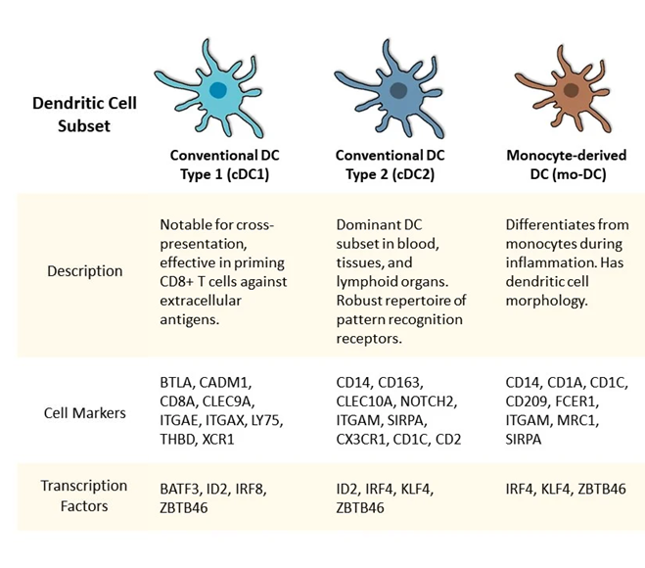
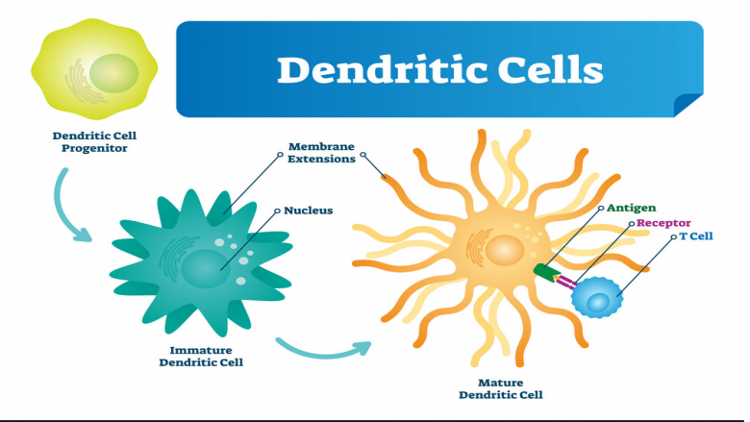
Dendritic Cells
Dendritic cells are key players in the immune system, functioning as antigen-presenting cells.
DCs can be broadly categorized into two main subtypes:
conventional dendritic cells (cDCs)
monocyte-derived dendritic cells (MoDCs).

Slide 3
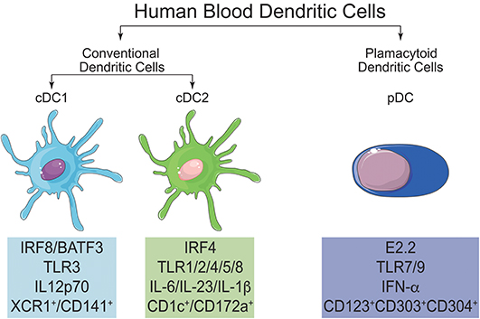
Conventional Dendritic Cells
cDCs originate from a specialized lineage of precursor cells in the bone marrow.
Divided into cDC1 and cDC2 subtypes based on expression markers (CD141, CD103, CD11b).
cDC1 is specialized in cross-presentation to CD8+ T cells, contributing to cytotoxic responses.
cDC2 is involved in presenting antigens to CD4+ T cells, crucial for orchestrating adaptive immune responses.

Slide 4
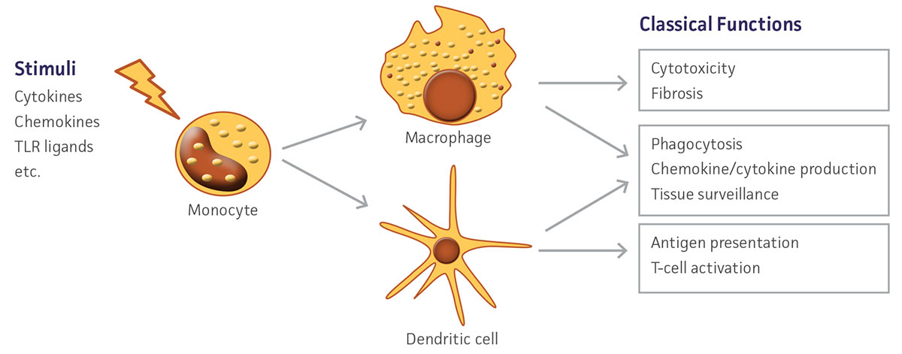
Monocyte-Derived Dendritic Cells
MoDCs are derived from circulating monocytes
Which differentiate into MoDCs in response to specific signals in inflammatory or infectious environments.
MoDCs share functions with cDCs, including antigen presentation and T cell activation.

Slide 5
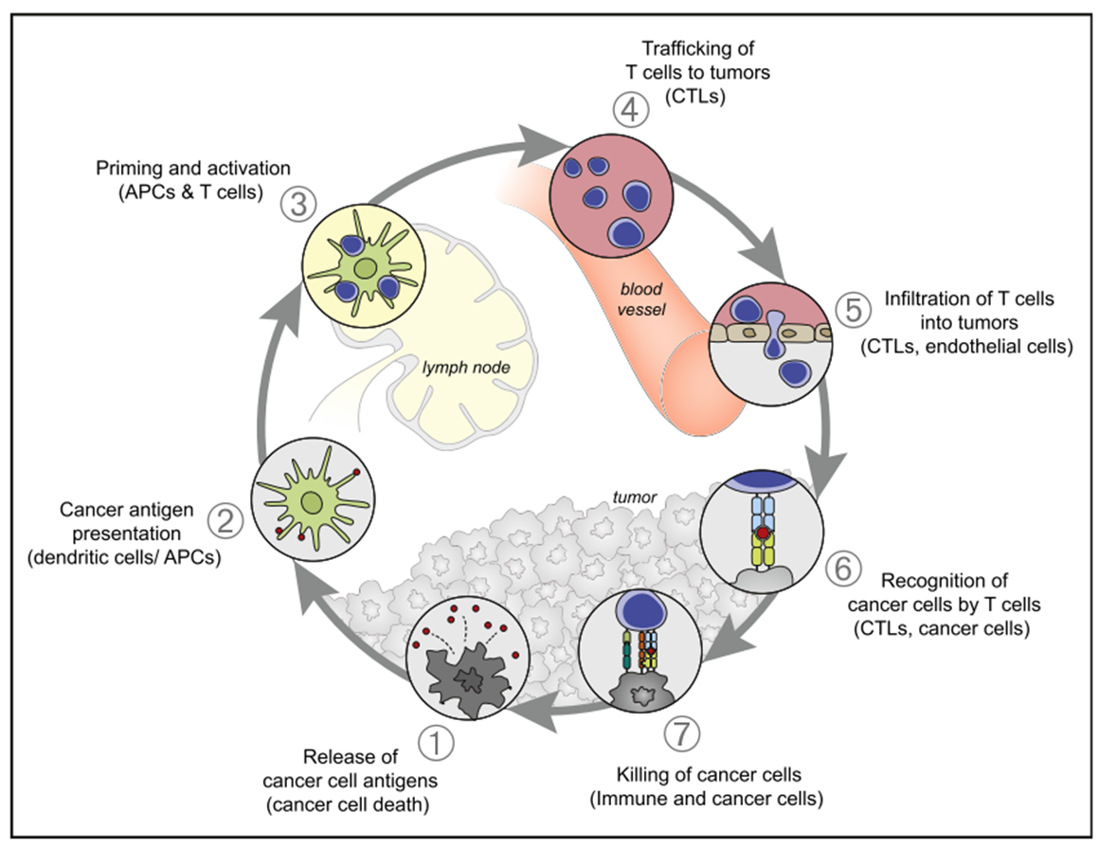
Priming and Licensing of DCs
Priming involves the initial activation of dendritic cells upon encountering antigens.
The maturation process enhances the ability of dendritic cells to effectively activate T cells.
Maturation involves the upregulation of co-stimulatory molecules (e.g., CD80 or CD86 == B7) and cytokine secretion, providing crucial signals for optimal T cell activation.

Slide 6
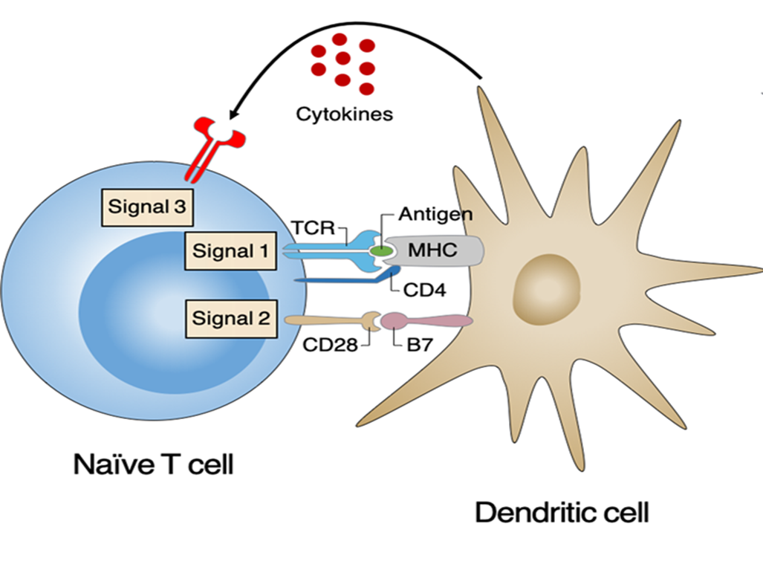
Priming and Licensing of DCs
Priming involves the initial activation of dendritic cells upon encountering antigens.
The maturation process enhances the ability of dendritic cells to effectively activate T cells.
Maturation involves the upregulation of co-stimulatory molecules (e.g., CD80 or CD86 == B7) and cytokine secretion, providing crucial signals for optimal T cell activation.

Slide 7
cDCs versus MoDCs
Both cDCs and MoDCs capture, process, and present antigens to T cells.
cDCs and MoDCs bridge innate and adaptive immunity by activating T cells, leading to the differentiation of effector T cell subsets.

Slide 8
Datasets
In vivo Mice:
DCs (Dendritic Cells) – in tumor vs in DLN (Draining Lymph Node). (21 August, 2021)
CD8+ T cells – in tumor vs in DLN. (21 July 2021)
In vitro Mice:
MoDCs – 6H activated vs 48H washed vs Naïve.
cDCs (Conventional Dendtritic Cells) – 6H activated vs Naïve.
CD8+ T Cells –
Treatments: Primed with cDCs, Primed with MoDCs, Primed with cDCs and Licensed with cDCs and Primed with cDCs and Licensed with MoDCs.
Control: CD3_28 stimulation and Naïve.
In vivo human: …In check ☺
B cell contamination

Slide 9
In Vitro T Cells Experiment Design

Slide 10
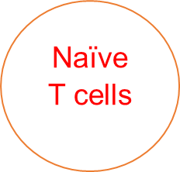
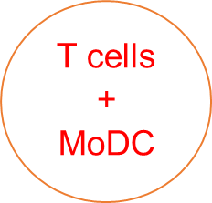
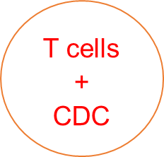
In Vitro T Cells Experiment Design
Primed
+ supernatant MoDC
+ supernatant cDC
Licensed

Slide 11
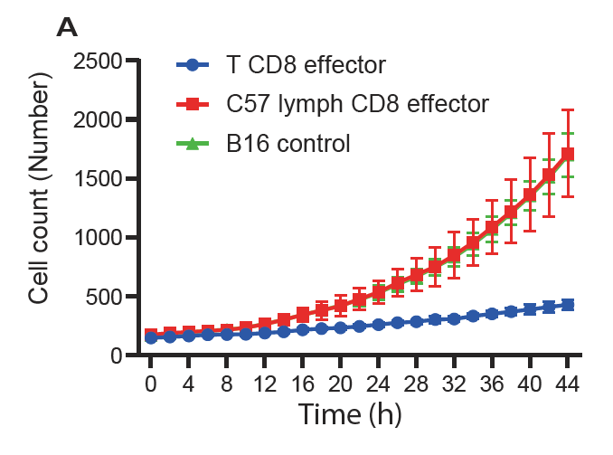
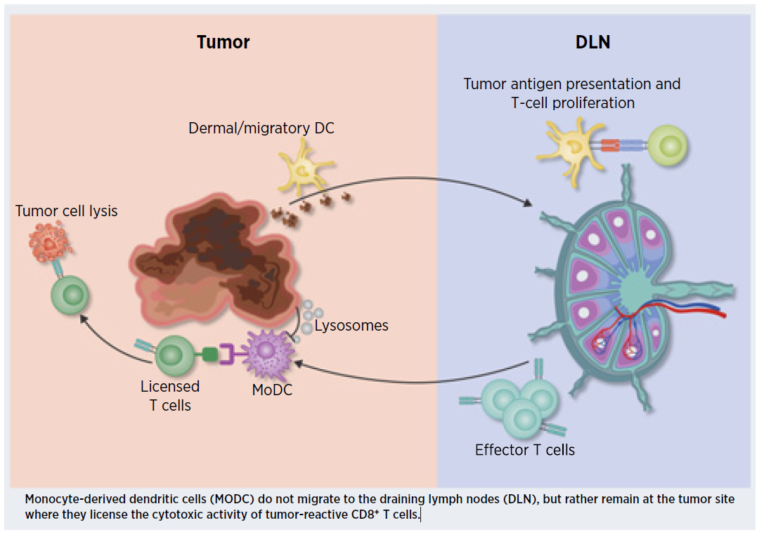
In Vivo Experiments Insights
Tumor
The in vivo experiments in mice show that CD8+ T cells from the tumor are more cytotoxic than CD8+ T cells from the DLN.
Monocyte-derived dendritic cells (MoDC) do not migrate to the draining lymph nodes (DLN), but rather remain at the tumor site where they license the cytotoxic activity of tumor-reactive CD8+ T cells. (Santana-Magal et al. 2021)

Slide 12
Hypothesis
CD8+ T cells primed with cDCs and licensed with MoDCs are more cytotoxic than CD8+ T cells primed with cDCs only, which should be reflected in their transcriptomic profiles.

Slide 13
Bioinformatic Methods
Deseq2 (Source).
Used 'regularized log' transformation Normalization (Source).
“mmusculus_gene_ensemble” mgi_symbol as gene names.
Raw counts data filtering = kept rows that have at least 10 reads in total.
For Heatmaps with more than 2 groups used DESeq function with LRT test for ANOVA-like statistical analysis across all samples (Calculates p-value only for the differentiation of all groups).
Heatmaps expression values are Z-score scaled by rows.
Circos DSA calculation by flow network method implemented for Bulk RNA-seq.

Slide 14
Motivation In Vivo Experiments CD8+ T cells (T/DLN) ; DCs (T/DLN)
What are the transcriptomic differences between CD8+ T cells in tumor and CD8+ T cells in DLN?
What are the transcriptomic differences between DCs in tumor and DCs in DLN?

Slide 15
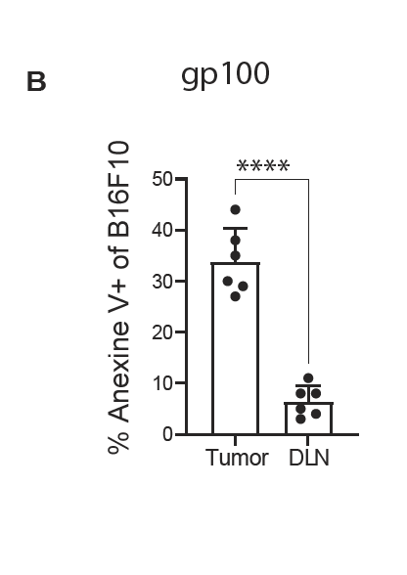
CD8+ in Tumor vs CD8+ in DLN In Vivo Mice Bench Results
6 samples from Tumor and DLN sorted into activated CD8+ T cells (CD3+, CD8+, CD44+).
Plot B – T cells that recognize gp100 tumoral peptide kill more in Tumor than in DLN.

Slide 16
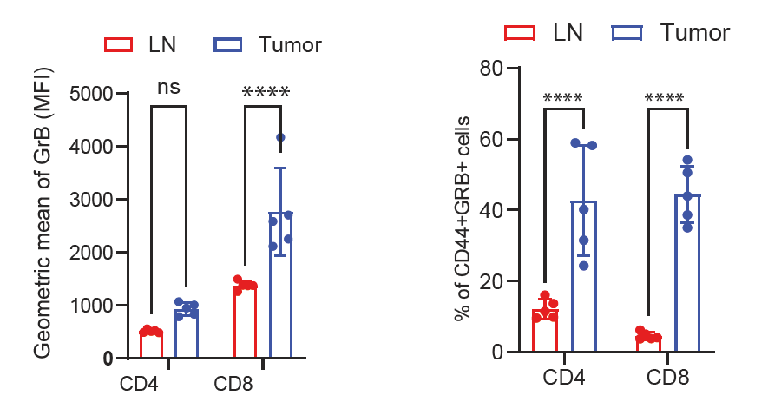
CD8+ in Tumor vs CD8+ in DLN In Vivo Mice Bench Results
These plots show that T cells are more cytotoxic and activated in tumor than in DLN.
CD44 is a marker of T cells activation on the T cells.
GrB (Gransyme B) secretion from T cells is a measure for T cells activation.
CD44+/Grb+ T cells were FACS sorted.

Slide 17
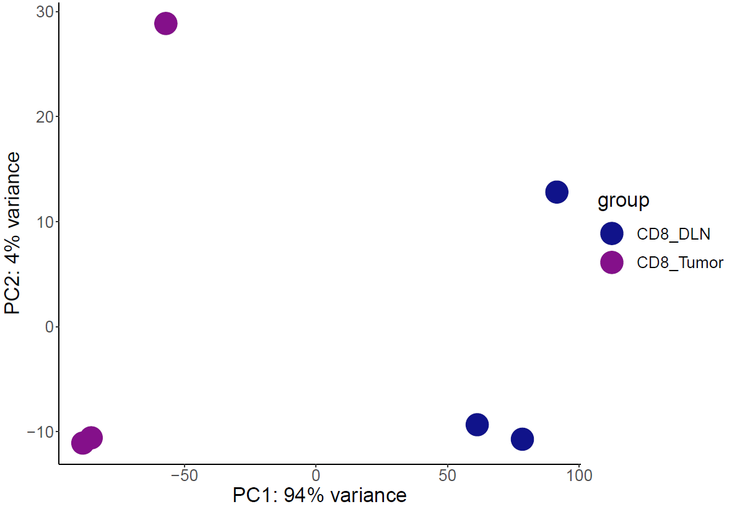
CD8+ in Tumor vs CD8+ in DLN In Vivo Mice Bioinformatic Results
PCA Plot

Slide 18
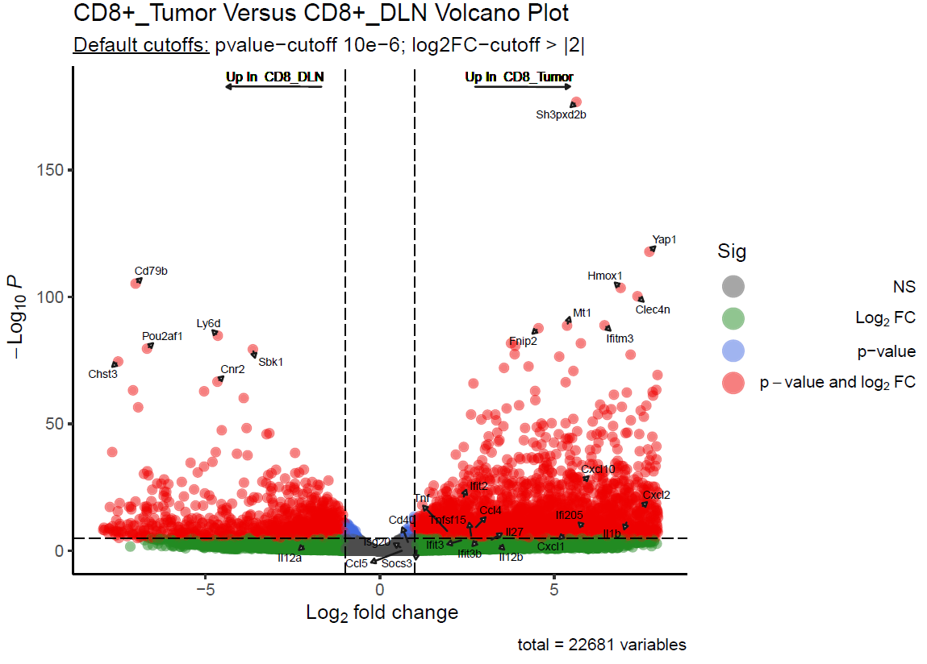
CD8+ in Tumor vs CD8+ in DLN In Vivo Mice Bioinformatic Results
Volcano plot CD8+ in Tumor vs CD8+ in DLN:
Labeled the following list of interest genes: "Il27","Il1b","Ifi205","Ifit3","Cd40", "Tnfsf15","Ccl5","Ifit3b","Cxcl10", "Cxcl2","Ifit2","Tnf","Il12b","Il12a", "Isg20","Socs3","Ccl4" and "Cxcl1" .
And top 10 P-value genes in logFC > 2 or logFC < -2 .
Il12, CD40, Il1b – markers of activation (in tumor).

Slide 19
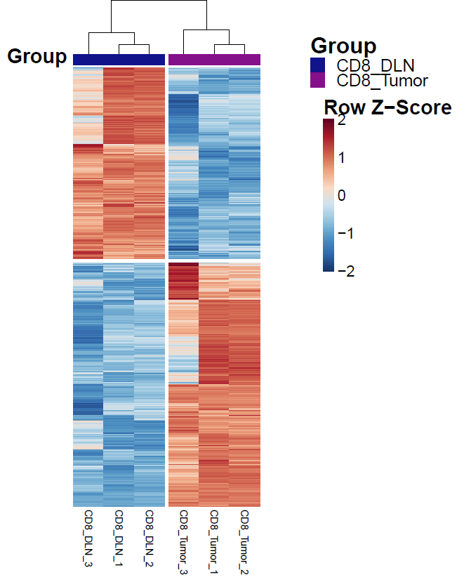
CD8+ in Tumor vs CD8+ in DLN In Vivo Mice Bioinformatic Results
Heatmap of All Differentially Expressed Genes (DEG) CD8+ in Tumor vs CD8+ in DLN :
Applied Wald test in DESeq DEG function across both groups.
Then kept only DE genes with padj (FDR) value less than 0.05.
ADD in all following heatmaps a sentence or visualization of the role of the specific genes

Slide 20
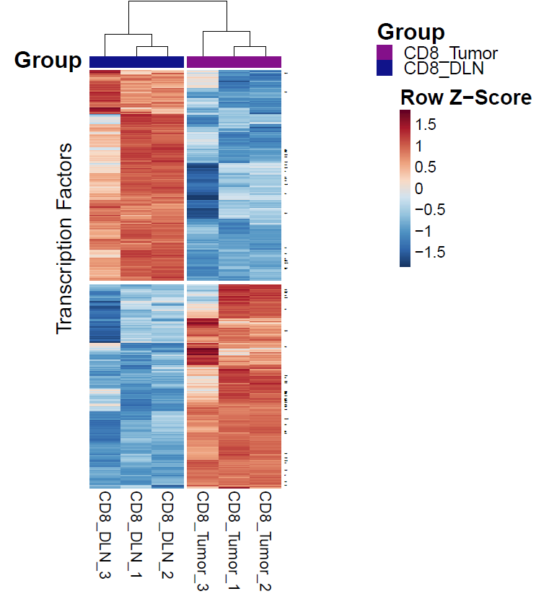
CD8+ in Tumor vs CD8+ in DLN In Vivo Mice Bioinformatic Results
Heatmap of Transcription Factors (TFs) of interest:
This heatmap presents the expression of chosen TFs’ genes from Shai Dulberg’s Mouse TFs gene list.
Zbtb18,Bmyc,Rfx1,Foxk1,Phf1,Prr12,Zfp652,Meis3, Smyd3,Rreb1,Zfp395,Cic,Xpa,Hes6,Usf2,Akap8l,Tfeb,Nfatc1,Lyl1,Tcf3,Cbx2,Fli1,Dbp,Zfp362,Zfp512b, Zfp414,Rxrb,Gtf2b,Zfp703,Fosl2,Nfxl1,Zfand5,Atf3, Zfp503,Rbpj,Cebpd,Nfix,Nfe2l2,Nr4a3,Mbnl2,Crem,Stat3,Etv6,Tcf4,Prdm1,Mxd1,Irf5,Nfkb2,Eea1,Nfe2l1,Hif1a,Plscr1,Jdp2,Trafd1,Msantd3,E2f8,Tfec,Mitf, Lhx2,Creb5,Cebpb,Pou3f1,Six1,Kcmf1,Irf7,Batf2 and Fosl1.
Nfkb2, Prdm1, Hif1a.

Slide 21
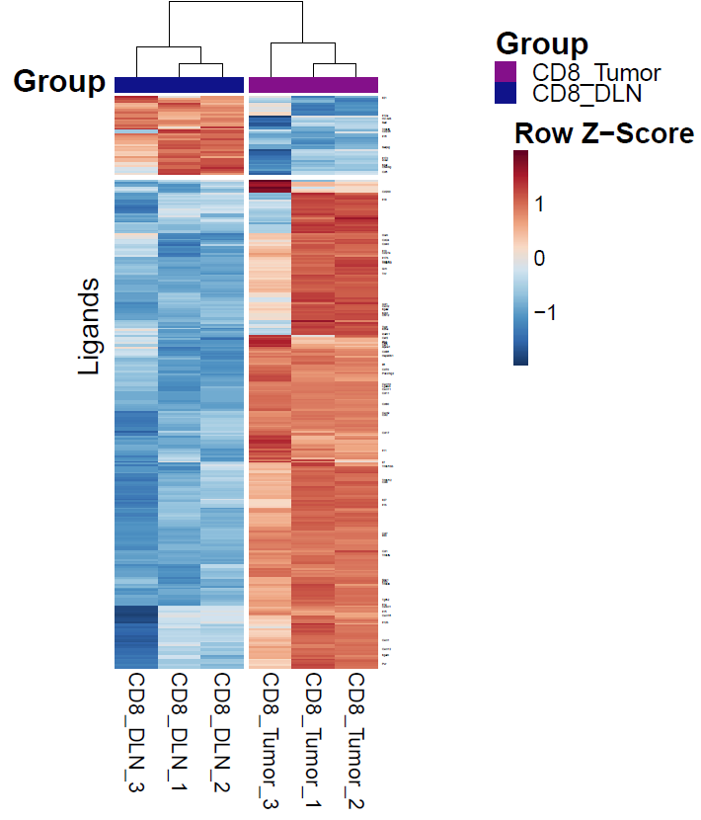
CD8+ in Tumor vs CD8+ in DLN In Vivo Mice Bioinformatic Results
Heatmap Ligands of interest:
This heatmap presents the expression of chosen Ligands’ genes from Shai Dulberg’s Ligands-Receptors gene list.
Il21,Il12a,H2−M3,Sell,Tnfsf8,Cd226,Il16,Selplg,Il17c,Icosl,Itgal,Cd40lg,Cd6,Cd200,Il18,Osm,Ccl24,Cd40, Il10,Cd274,Il17b,Tnfsf11,Tnfsf10,Grn,Tnf,Xcl1,Cxcl2, Itga9,Itgb1,Ccl12,Tigit,Il23a,Icam1,Csf2,Ifng,Fasl, Csf1,Apoa1,Cd86,Hsp90b1,Il6,Cd70,Pdcd1lg2,Cxcl10,Lgals3,Cxcl11,Ccl11,Cd80,Cxcl9,Ccl2,Ccl17,Il11,Il7,Tnfsf13b,Tnfsf12,Ccl8,Il27,Il1b,Ccl7,Il33,Ccl1,Tnfsf9, Spp1,Il1rn,Tnfsf4,Tgfb2,Il1a,Cx3cl1,Il15,Cxcl16,Il12b,Cxcl1,Cxcl12,Itgam and Pvr.
Il21, Tigit, Il10, Tnf.

Slide 22
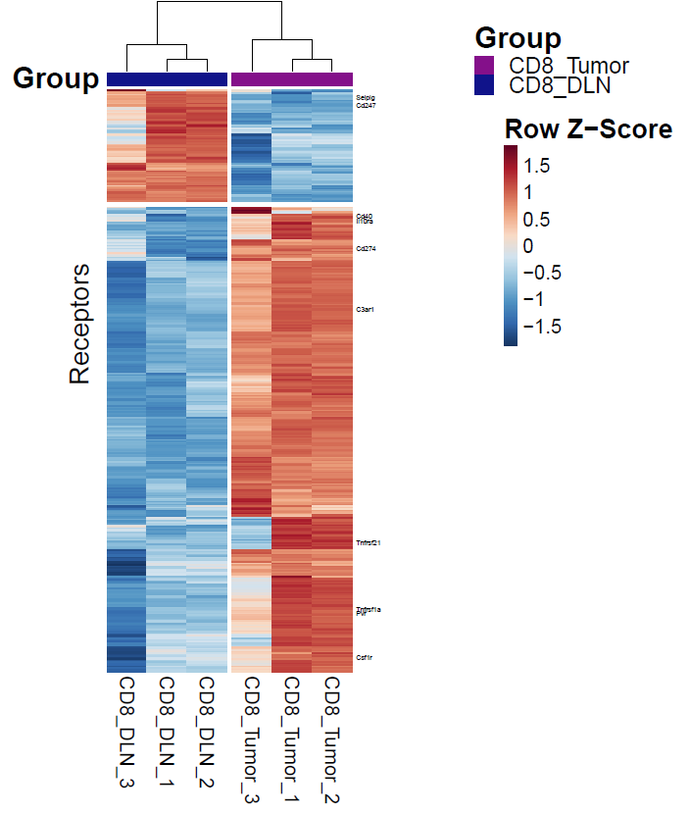
CD8+ in Tumor vs CD8+ in DLN In Vivo Mice Bioinformatic Results
Heatmap Receptors of interest:
This heatmap presents the expression of chosen Receptors’ genes from Shai Dulberg’s Ligands-Receptors gene list.
Selplg,Cd247,Cd40,Il10ra,Cd274, C3ar1,Tnfrsf21,Tnfrsf1a,Pvr and Csf1r
Selplg, Tnfrsf1a and Pvr.

Slide 23
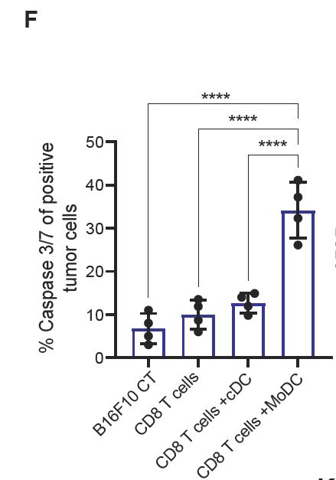
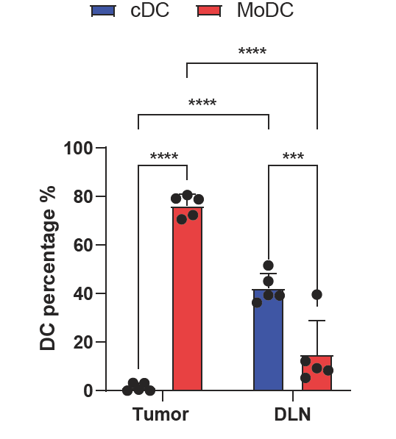
DCs in Tumor vs DCs in DLN In Vivo Mice Bench Results
There are more dead tumor cells in CD8+ T cells licensed with MoDC than in CD8+ T cells primed with cDC.
The abundance of MoDCs is greater
in the tumor than in the DLN, where
cDCs are more abundant.

Slide 24
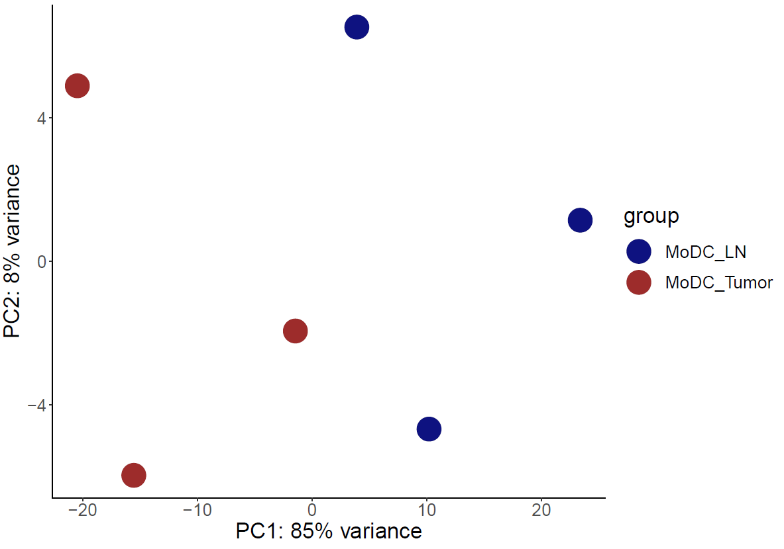
DCs in Tumor vs DCs in DLN In Vivo Mice Bioinformatic Results
PCA Plot

Slide 25
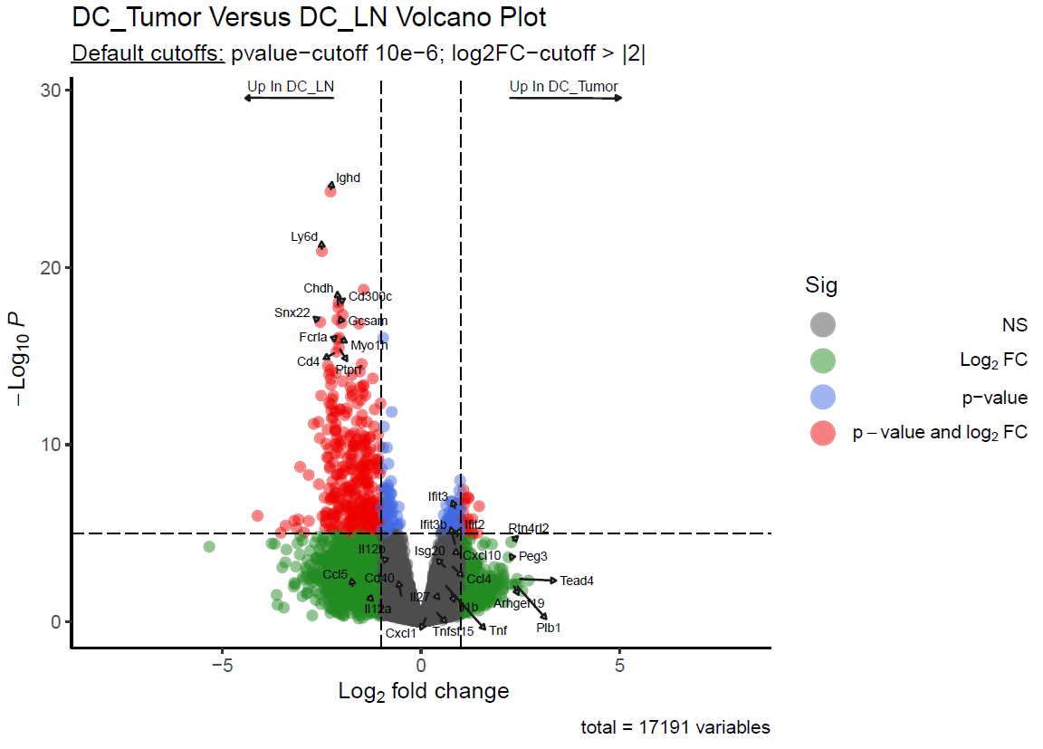
Pan DCs in Tumor vs Pan DCs in DLN In Vivo Mice Bioinformatic Results
Volcano plot DCs in Tumor vs DCs in DLN:
Labeled the following list of interest genes: "Il27","Il1b","Ifi205","Ifit3","Cd40", "Tnfsf15","Ccl5","Ifit3b","Cxcl10", "Cxcl2","Ifit2","Tnf","Il12b","Il12a", "Isg20","Socs3","Ccl4" and "Cxcl1" .
And top 10 P-value genes in logFC > 2 or logFC < -2 .

Slide 26
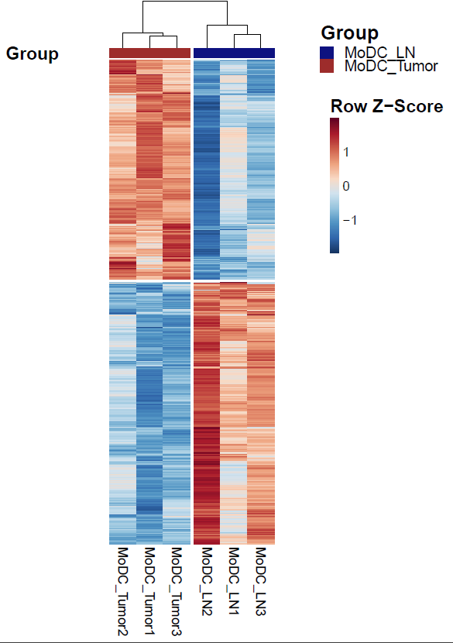
DCs in Tumor vs DCs in DLN In Vivo Mice Bioinformatic Results
Heatmap of All Differentially Expressed Genes (DEG) DCs in Tumor vs DCs in DLN:
Applied Wald test in DESeq DEG function across both groups.
Then kept only DE genes with padj (FDR) value less than 0.05.

Slide 27
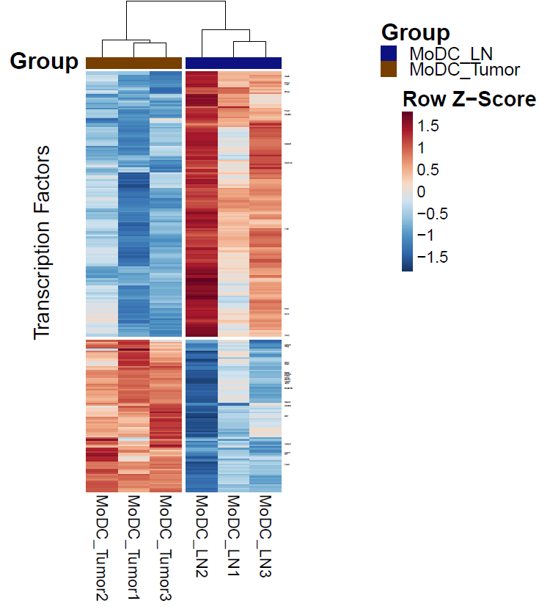
DCs in Tumor vs DCs in DLN In Vivo Mice Bioinformatic Results
Heatmap of Transcription Factors (TFs) of interest:
This heatmap presents the expression of chosen TFs’ genes from Shai Dulberg’s Mouse TFs gene list.
Hes6,Prr12,Tcf3,Bmyc,Foxk1, Zfp362,Akap8l,Zfp512b,Tcf4,Phf1,Rxrb,Cbx2,Cebpb,Rbpj,Nfxl1,Eea1, Batf2,Zfp703,Fosl2,Hif1a,Mbnl2, Creb5,Jdp2,Msantd3,Nfe2l2, Zfp503,Mitf,Cebpd,Kcmf1,Irf7 and Crem.
Hif1a and Irf7.

Slide 28
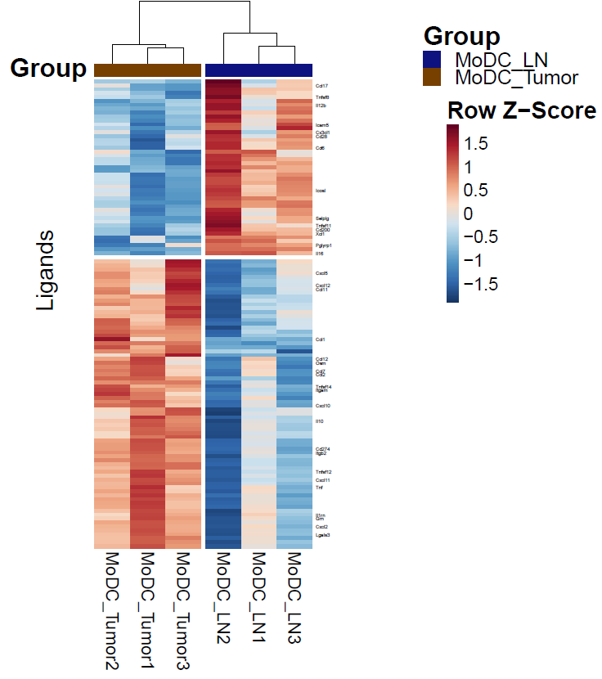
DCs in Tumor vs DCs in DLN In Vivo Mice Bioinformatic Results
Heatmap Ligands of interest:
This heatmap presents the expression of chosen Ligands’ genes from Shai Dulberg’s Ligands-Receptors gene list.
Ccl17,Tnfsf8,Il12b,Icam5,Cx3cl1, Cd28,Cd6,Icosl,Selplg,Tnfsf11, Cd200,Xcl1,Pglyrp1,Il16,Cxcl5, Cxcl12,Ccl11,Ccl1,Ccl12,Osm,Ccl7, Ccl2,Tnfsf14,Itgam,Cxcl10,Il10, Cd274,Itgb2,Tnfsf12,Cxcl11,Tnf, Il1rn,Grn,Cxcl2 and Lgals3.
Tnf, Il10, Cxcl10.

Slide 29
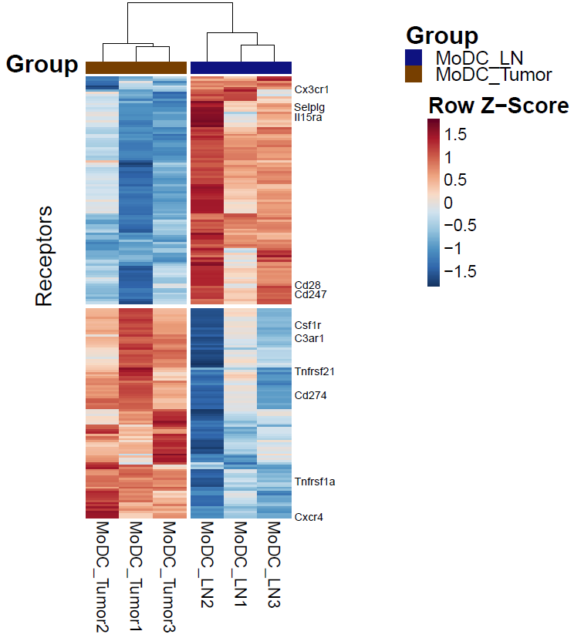
DCs in Tumor vs DCs in DLN In Vivo Mice Bioinformatic Results
Heatmap Receptors of interest:
This heatmap presents the expression of chosen Receptors’ genes from Shai Dulberg’s Ligands-Receptors gene list.
Cx3cr1, Selplg, Il15ra,Cd28,Cd247,Csf1r,C3ar1, Tnfrsf21,Cd274,Tnfrsf1a and Cxcr4
Cxcr4.

Slide 30
Motivation MoDC/cDC In Vitro Experiments
What are the transcriptomic differences between MoDCs after 6H treatment of LPS vs Naïve MoDCs?
What are the transcriptomic differences between cDCs after 6H treatment of LPS vs Naïve cDCs?
What are the transcriptomic differences between MoDC 6H/Naive and cDC 6H/Naive?

Slide 31
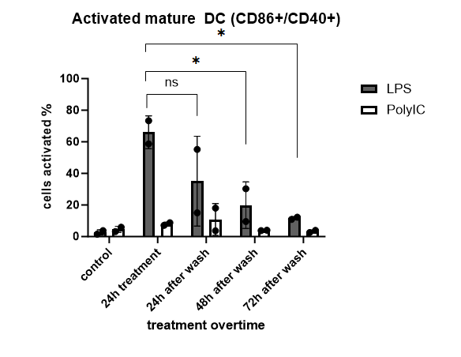
MoDC Activated vs Naive In Vitro Mice Bench Results
After treatment with LPS for 6H and 24H, there’s a rise in expression of activation markers (CD86, CD40) of the moDCs.
After wash, the expression of the activation markers decreased.

Slide 32
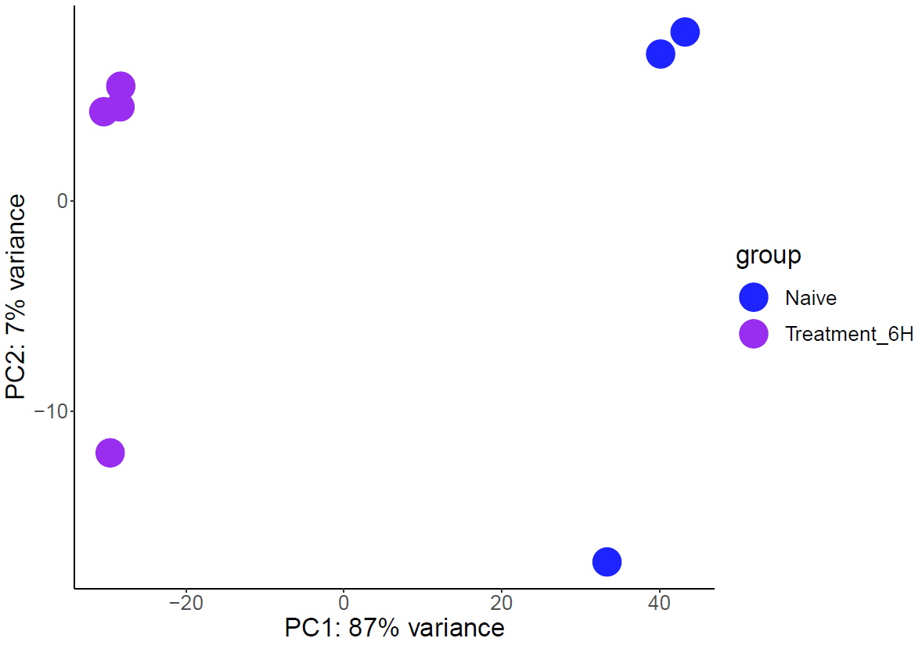
MoDC Activated vs Naive In Vitro Mice Bioinformatic Results
PCA Plot

Slide 33
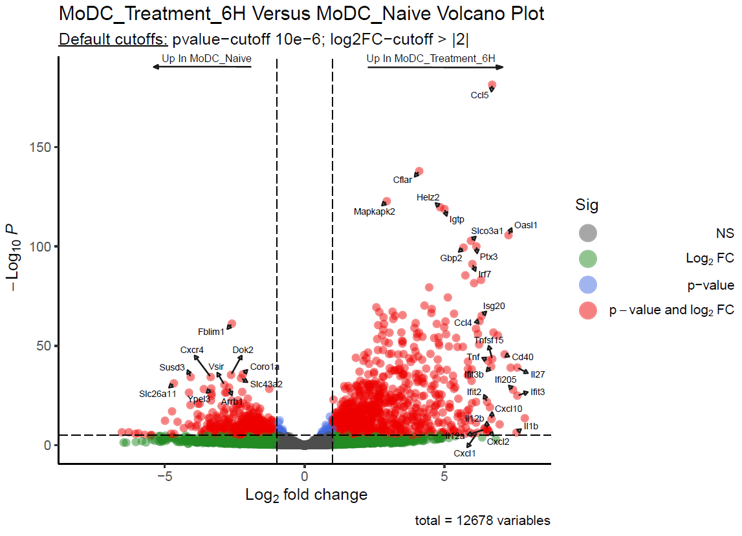
MoDC Activated vs Naive In Vitro Mice Bioinformatic Results
Volcano Plot 6H Treatment vs Naive:
Labeled the following list of interest genes: "Il27","Il1b","Ifi205","Ifit3","Cd40", "Tnfsf15","Ccl5","Ifit3b","Cxcl10", "Cxcl2","Ifit2","Tnf","Il12b","Il12a", "Isg20","Socs3","Ccl4" and "Cxcl1".
And top 10 P-value genes in logFC > 2 or logFC < -2.

Slide 34
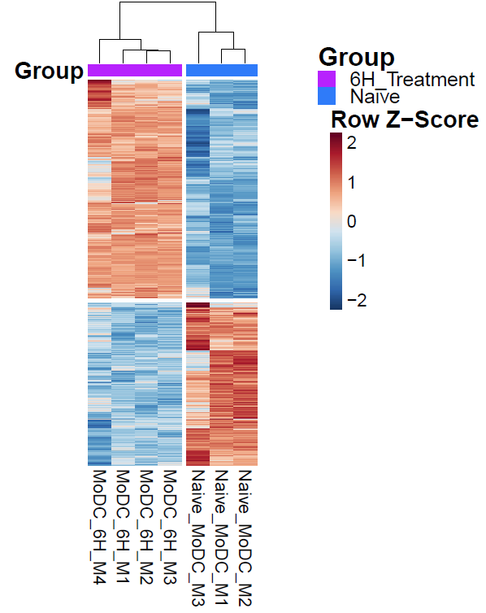
MoDC Activated vs Naive In Vitro Mice Bioinformatic Results
Heatmap of All Differentially Expressed Genes (DEG):
Applied Wald test in DESeq DEG function across both groups.
Then kept only DE genes with padj (FDR) value less than 0.05.

Slide 35
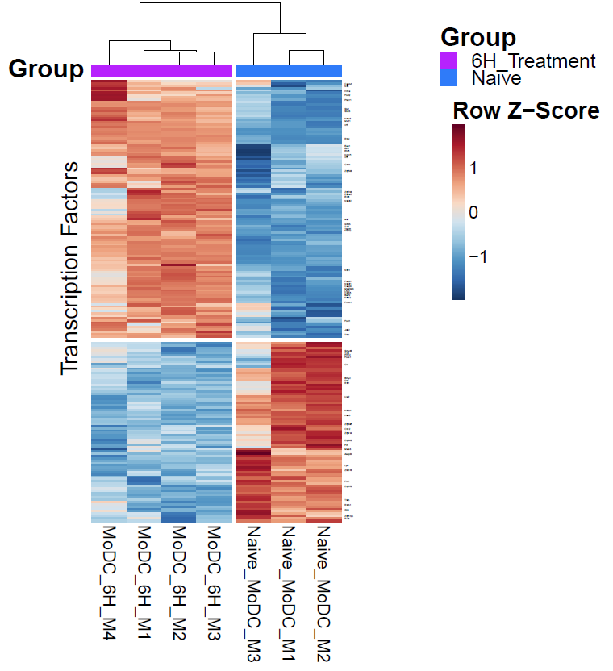
MoDC Activated vs Naive In Vitro Mice Bioinformatic Results
Heatmap of Transcription Factors (TFs) of interest:
This heatmap presents the expression of chosen TFs’ genes from Shai Dulberg’s Mouse TFs gene list.
Cebpd,Nfix,Hif1a,Fosl2,Plscr1,Six1,Stat3,Nr4a3,Mxd1,Irf7,Rbpj,Eea1,Atf3,Etv6,Kcmf1,Irf5,Crem,Zfp503,Zfp703,Zfand5,E2f8,Nfe2l2,Mitf, Gtf2b,Tcf4,Trafd1,Mbnl2,Nfxl1, Pou3f1,Nfe2l1,Cebpb,Msantd3, Lhx2,Creb5,Batf2,Nfkb2,Prdm1, Fosl1,Jdp2,Tfec,Smyd3,Tcf3,Prr12, Foxk1,Cic,Bmyc,Dbp,Rfx1,Usf2, Nfatc1,Hes6,Zfp395,Cbx2,Zfp414, Zfp362,Fli1,Meis3,Akap8l,Lyl1, Zbtb18,Phf1,Zfp652,Tfeb,Rreb1, Xpa,Zfp512b and Rxrb
Nr4a3, Prdm1.

Slide 36
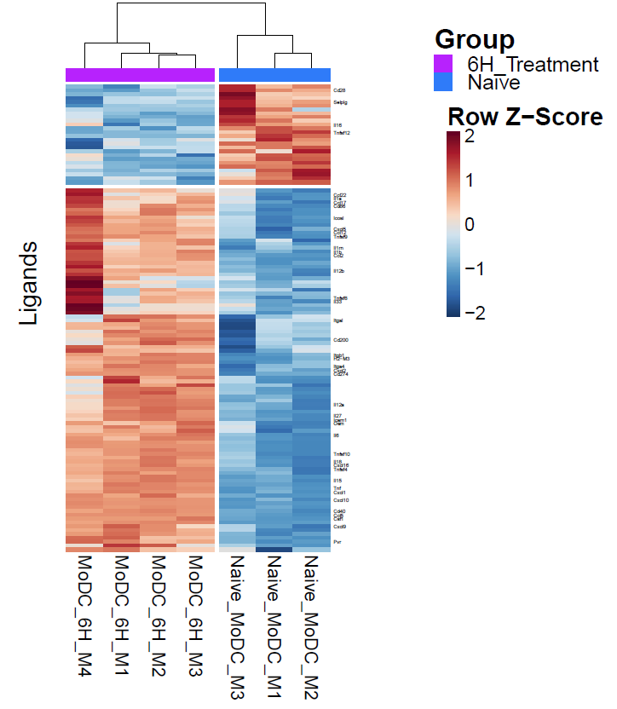
MoDC Activated vs Naive In Vitro Mice Bioinformatic Results
Heatmap Ligands of interest:
This heatmap presents the expression of chosen Ligands’ genes from Shai Dulberg’s Ligands-Receptors gene list.
Cd28,Selplg,Il16,Tnfsf12,Ccl22,Il1a, Ccl17,Cd86,Icosl,Cxcl5,Ccl12,Tnfsf9, Il1rn,Il1b,Ccl2,Il12b,Tnfsf8,Il33, Itgal,Cd200,Itgb1,H2−M3,Itga4,Cxcl2, Cd274,Il12a,Il27,Icam1,Osm,Il6,Tnfsf1, Il18,Cxcl16,Tnfsf4,Il15,Tnf,Cxcl1,Cxcl10,Cd40,Ccl5,Csf1,Cxcl9 and Pvr.
Pvr, Tnfrsf9, Icosl.

Slide 37
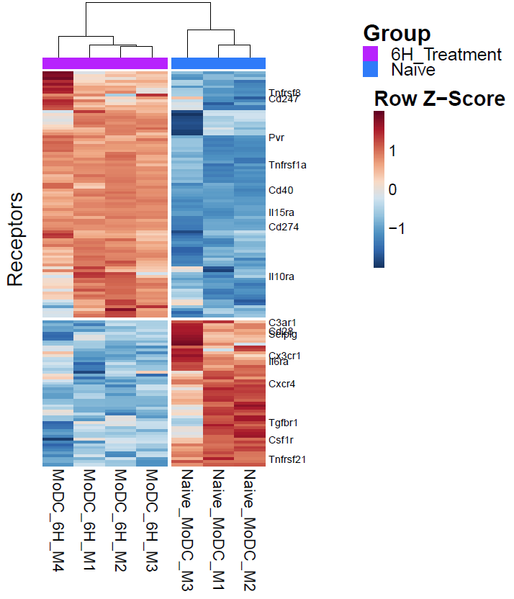
MoDC Activated vs Naive In Vitro Mice Bioinformatic Results
Heatmap Receptors of interest:
This heatmap presents the expression of chosen Receptors’ genes from Shai Dulberg’s Ligands-Receptors gene list.
TCndf2rs4f78,Pvr,Tnfrsf1a,Cd40, Il15ra,Cd274,Il10ra,C3ar1, SCedl2p8lg,ICl6xr3acr1,Cxcr4, Tgfbr1,Csf1r and Tnfrsf21.
Cd40, Tnfrsf1a.

Slide 38
cDC CD11c Activated vs Naive In Vitro Mice Bench Results

Slide 39
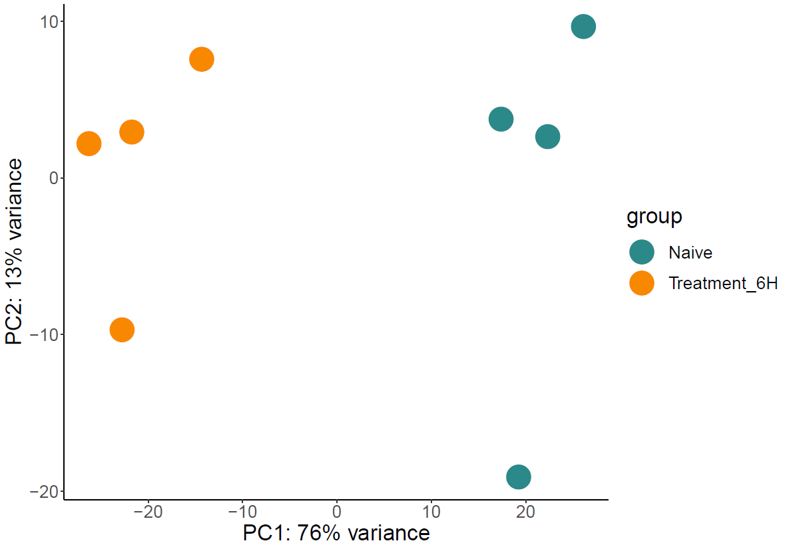
cDC CD11c Activated vs Naive In Vitro Mice Bioinformatic Results
PCA Plot

Slide 40
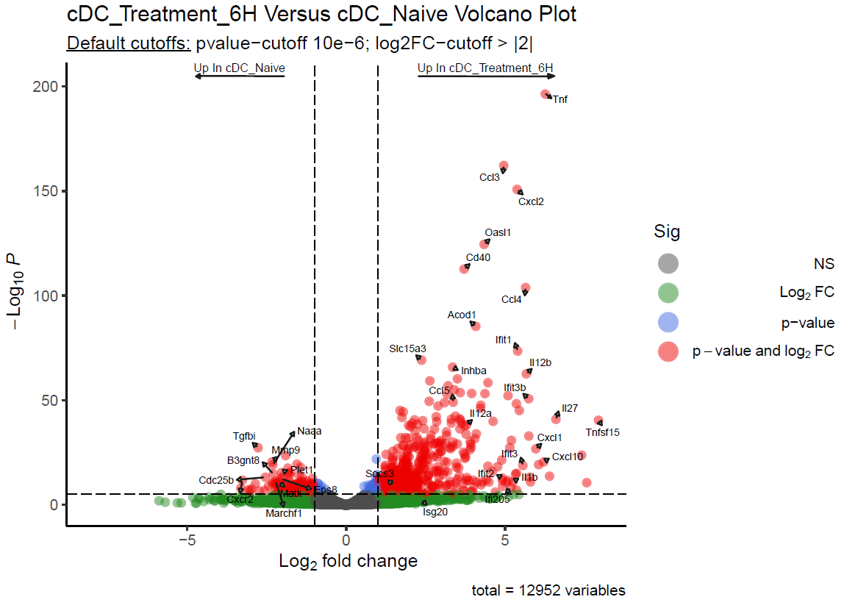
cDC CD11c Activated vs Naive In Vitro Mice Bioinformatic Results
Volcano Plot 6H Treatment vs Naive:
Labeled the following list of interest genes: "Il27","Il1b","Ifi205","Ifit3","Cd40", "Tnfsf15","Ccl5","Ifit3b","Cxcl10", "Cxcl2","Ifit2","Tnf","Il12b","Il12a", "Isg20","Socs3","Ccl4" and "Cxcl1".
And top 10 P-value genes in logFC > 2 or logFC < -2. (As previously with MoDC Experiment)

Slide 41
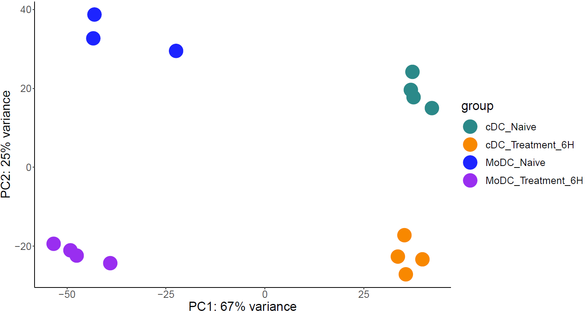
MoDC vs cDC CD11c In Vitro Mice Bioinformatic Results
PCA Plot

Slide 42
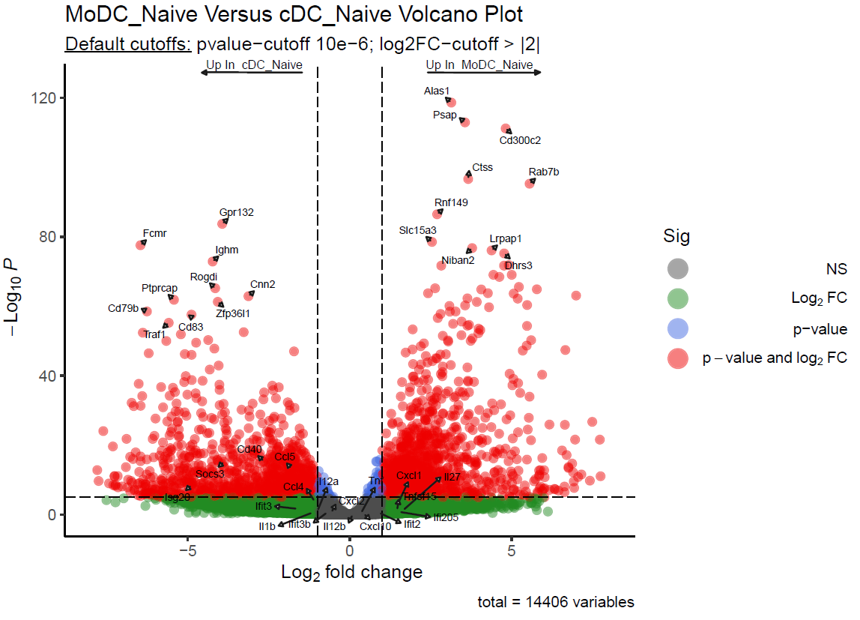
MoDC vs cDC CD11c In Vitro Mice Bioinformatic Results
Volcano Plot MoDC Naive Vs cDC Naive:
Labeled the following list of interest genes: "Il27","Il1b","Ifi205","Ifit3","Cd40", "Tnfsf15","Ccl5","Ifit3b","Cxcl10", "Cxcl2","Ifit2","Tnf","Il12b","Il12a", "Isg20","Socs3","Ccl4" and "Cxcl1" .
And Top-10 P-value genes in logFC > 2 or logFC < -2.

Slide 43
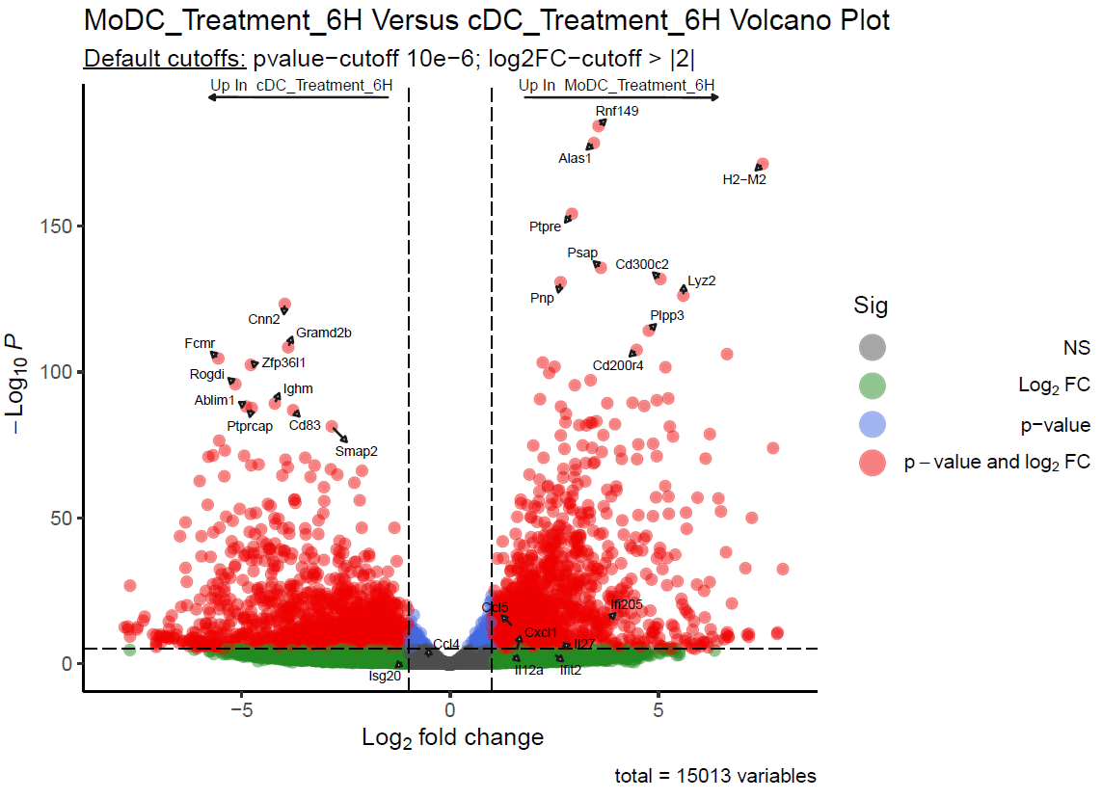
MoDC vs cDC CD11c In Vitro Mice Bioinformatic Results
Volcano Plot MoDCs 6H Treatment Versus cDCs_6H Treatment:
Labeled the following list of interest genes: "Il27","Il1b","Ifi205","Ifit3","Cd40", "Tnfsf15","Ccl5","Ifit3b","Cxcl10", "Cxcl2","Ifit2","Tnf","Il12b","Il12a", "Isg20","Socs3","Ccl4" and "Cxcl1" .
And Top-10 P-value genes in logFC > 2 or logFC < -2.
Cytokine only DEG table is available.

Slide 44
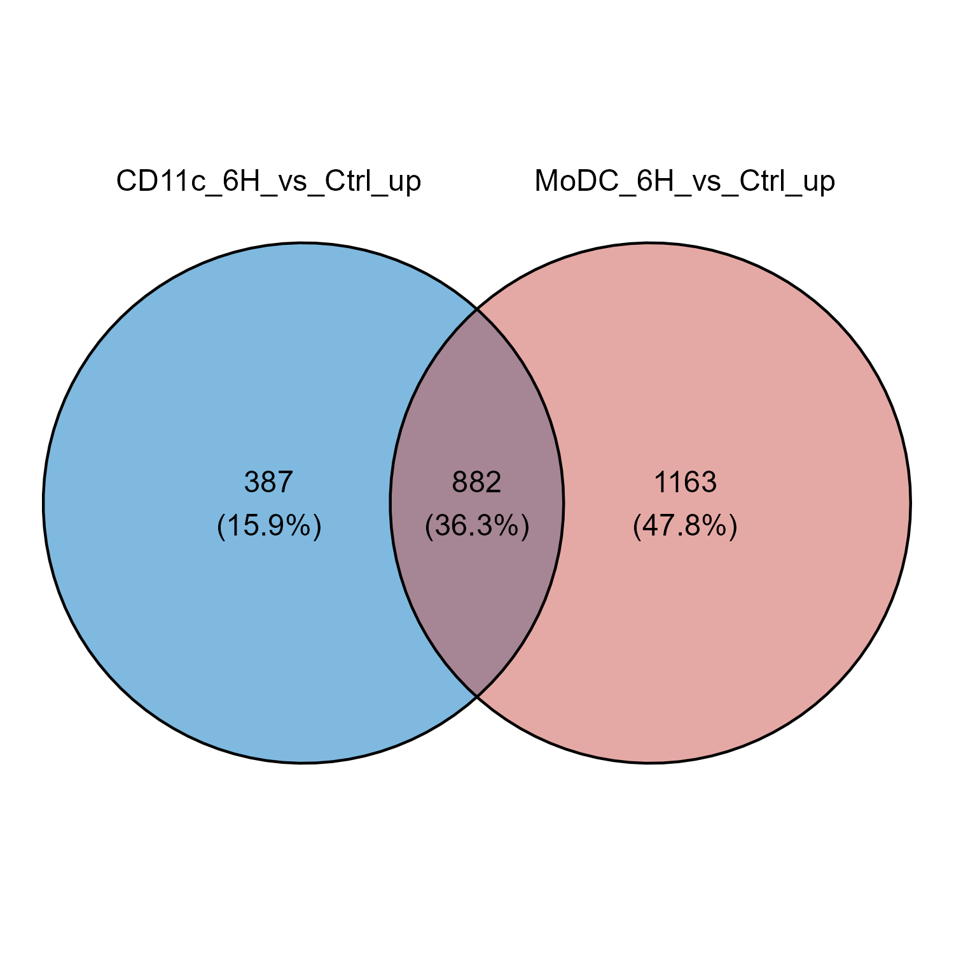
MoDC vs cDC CD11c In Vitro Mice Bioinformatic Results
DEGs tables have been taken from each part of the Venn.

Slide 45
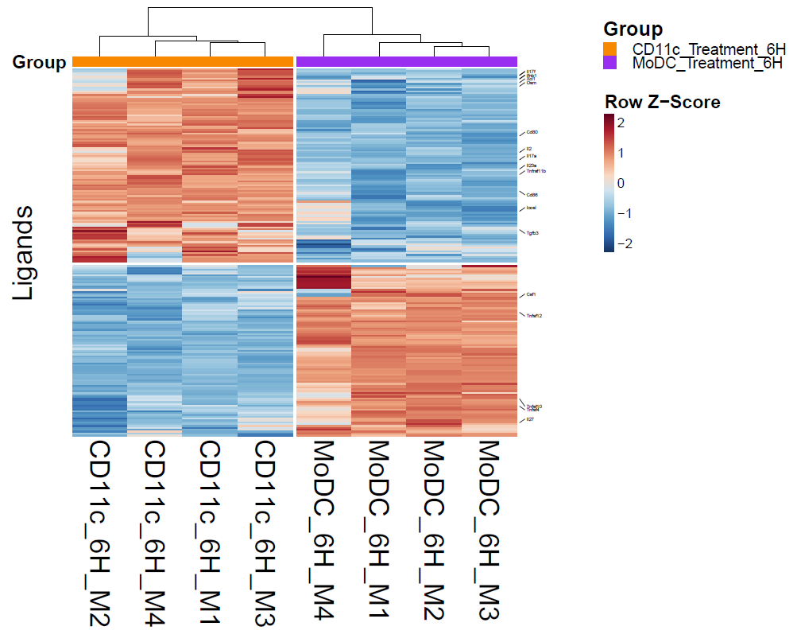
MoDC vs cDC CD11c In Vitro Mice Bioinformatic Results
Heatmap Ligands of interest MoDCs 6H vs cDCs 6H:
This heatmap presents the expression of chosen Ligands’ genes from Shai Dulberg’s Ligands-Receptors gene list.
Il17f,Ifnb1,Xcl1,Osm,Cd80,Il2, Il17a,Il23a,Tnfrsf11b,Cd86, Icosl,Tgfb3,Csf1,Tnfsf12,Tnfsf10,Tnfsf4 and Il27.
Csf1,Tnfsf4.

Slide 46
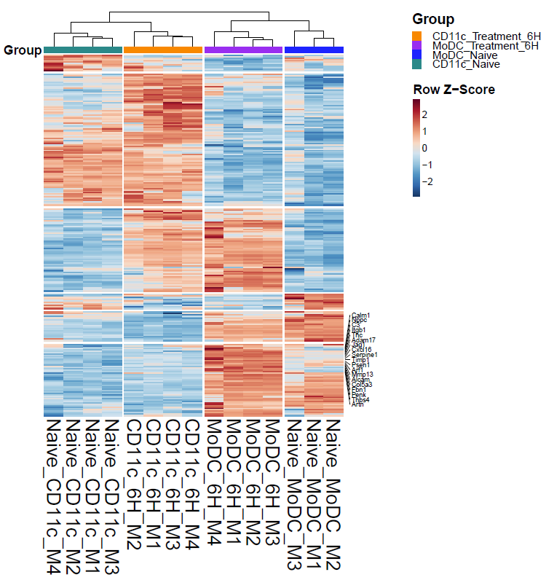
MoDC vs cDC CD11c In Vitro Mice Bioinformatic Results
Heatmap Ligands of interest MoDCs 6H vs cDCs 6H compared to MoDCs Naïve and cDCs Naïve:
This heatmap presents the expression of chosen Ligands’ genes from Shai Dulberg’s Ligands-Receptors gene list.
The shown uniquely up regulated genes in MoDC 6H experiment are: Calm1, Nppc, C3, Itgb1, Tnc, Adam17, Jag1, Cxcl16, Serpine1, Timp1, Psen1, Arf1, Mmp13, Alcam, Col5a3, Fbn1, Penk, Thbs4 and Artn.
Cxcl16, Alcam.
Unique up regulated gene expression of MoDCs 6H

Slide 47
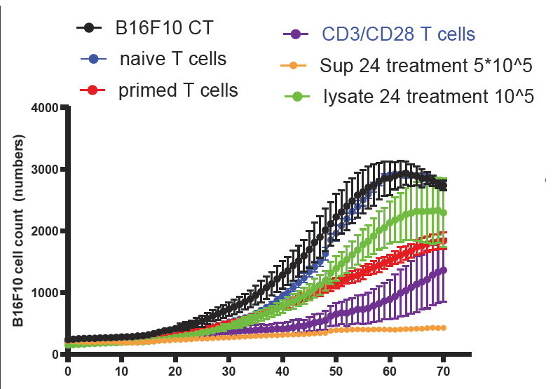
CD8+ T cells Primed/Licensed vs CD3_28 vs Naïve In Vitro Mice Bench Results
Killing assay of B16 tumor cells.
Sup = MoDC medium (what MoDC cells secret).
Lysate = Lysis of MoDC cells.
B16 tumor cell count dropped dramatically with T cells that are activated from MoDCs’ medium (Sup, dark yellow).

Slide 48
Motivation CD8+ T cells In Vitro Experiment
What are the transcriptomic differences between CD8+ T cells with various Priming and Licensing combinations of DCs?
Which transcriptomic differences occur between CD8+ T cells with Primed MoDCs and CD8+ T cells with Primed cDCs?
Which transcriptomic differences occur between CD8+ T cells with Licensed MoDCs and CD8+ T cells with Licensed cDCs when both are initially primed with cDC?

Slide 49
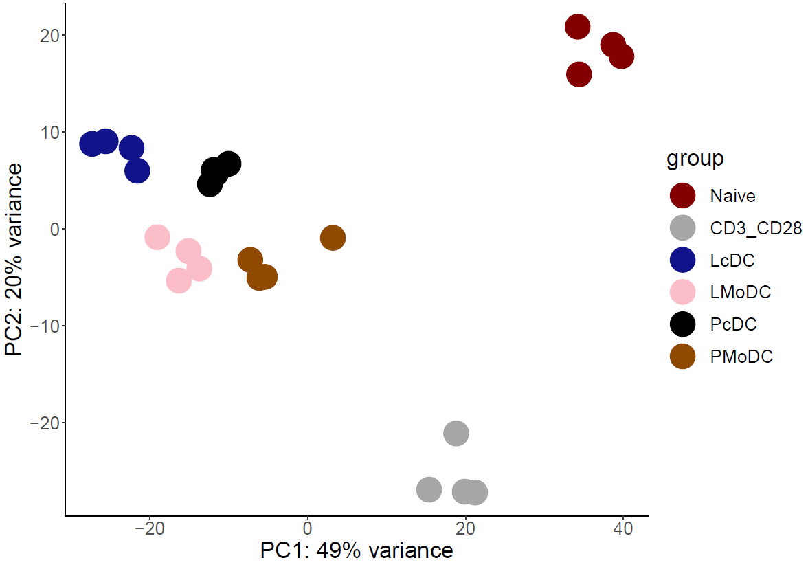
CD8+ T cells Primed/Licensed vs CD3_28 vs Naïve In Vitro Mice Bioinformatic Results
PCA Plot All Samples:

Slide 50
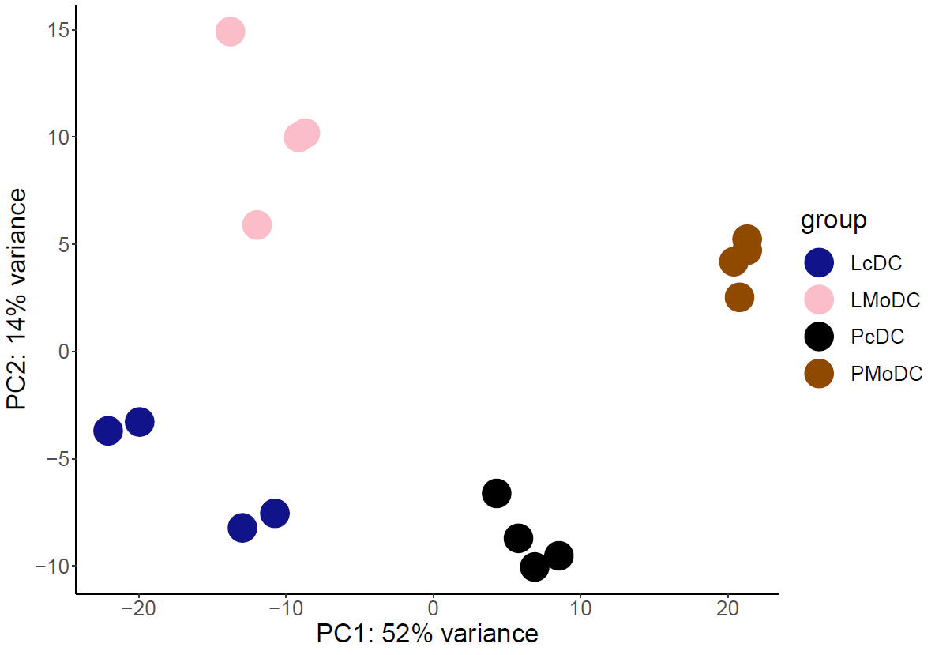
CD8+ T cells Primed/Licensed vs CD3_28 vs Naïve In Vitro Mice Bioinformatic Results
PCA Plot Treatments Only (Priming and Licensing):

Slide 51
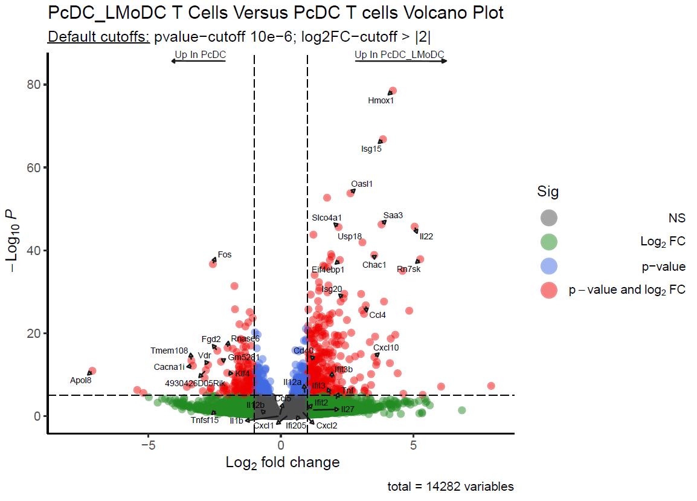
CD8+ T cells Primed/Licensed vs CD3_28 vs Naïve In Vitro Mice Bioinformatic Results
Volcano plots CD8+ T cells with PcDC+LMoDC Versus CD8+ T cells with PcDC only:
Labeled the following list of interest genes: "Il27","Il1b","Ifi205","Ifit3","Cd40", "Tnfsf15","Ccl5","Ifit3b","Cxcl10", "Cxcl2","Ifit2","Tnf","Il12b","Il12a", "Isg20","Socs3","Ccl4" and "Cxcl1" .
And Top-10 P-value genes in logFC > 2 or logFC < -2.

Slide 52
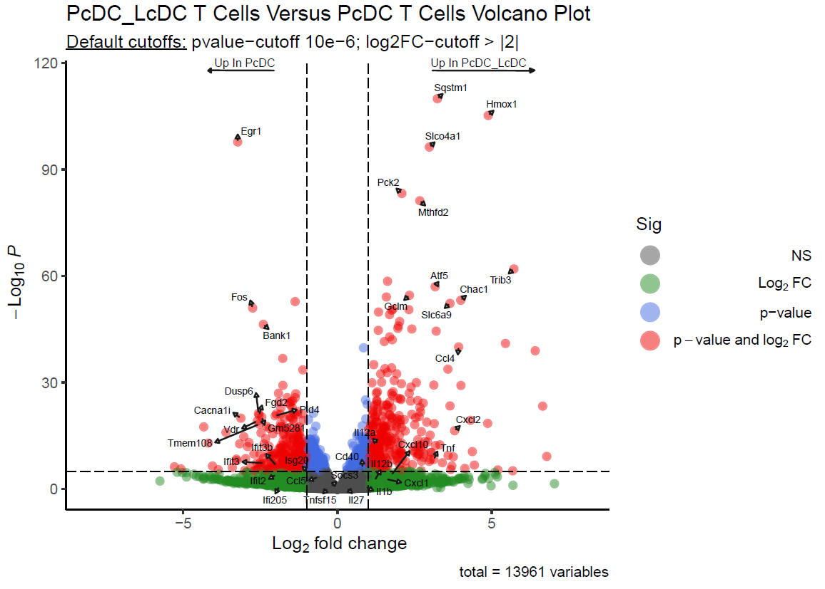
CD8+ T cells Primed/Licensed vs CD3_28 vs Naïve In Vitro Mice Bioinformatic Results
Volcano plots CD8+ T cells with PcDC+LcDC Versus CD8+ T cells with PcDC only:
Labeled the following list of interest genes: "Il27","Il1b","Ifi205","Ifit3","Cd40", "Tnfsf15","Ccl5","Ifit3b","Cxcl10", "Cxcl2","Ifit2","Tnf","Il12b","Il12a", "Isg20","Socs3","Ccl4" and "Cxcl1" .
And Top-10 P-value genes in logFC > 2 or logFC < -2.

Slide 53
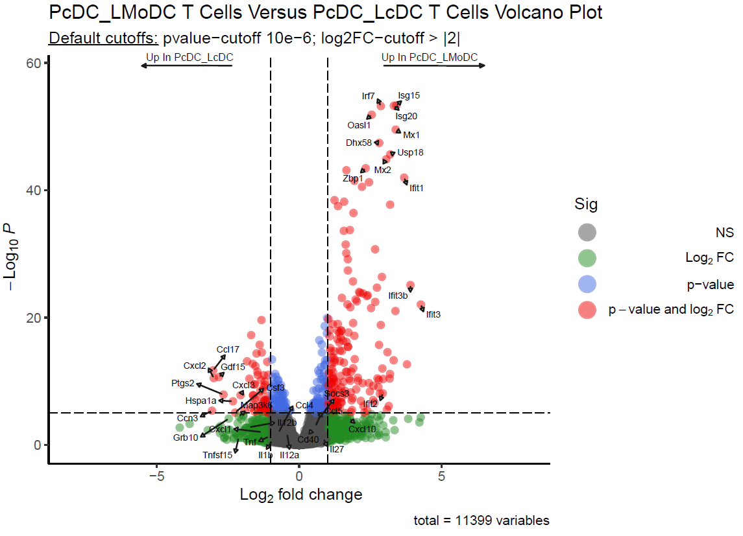
CD8+ T cells Primed/Licensed vs CD3_28 vs Naïve In Vitro Mice Bioinformatic Results
Volcano plots CD8+ T cells with PcDC+LMoDC Versus CD8+ T cells with PcDC+LcDC only:
Labeled the following list of interest genes: "Il27","Il1b","Ifi205","Ifit3","Cd40", "Tnfsf15","Ccl5","Ifit3b","Cxcl10", "Cxcl2","Ifit2","Tnf","Il12b","Il12a", "Isg20","Socs3","Ccl4" and "Cxcl1" .
And Top-10 P-value genes in logFC > 2 or logFC < -2.

Slide 54
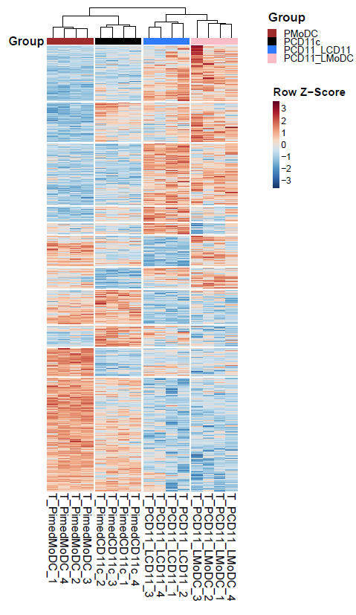
CD8+ T cells Primed/Licensed vs CD3_28 vs Naïve In Vitro Mice Bioinformatic Results
Heatmap of All Differentially Expressed Genes (DEG):
Applied LRT test in DESeq DEG function across all samples.
Then kept only DE genes with padj (FDR) value less than 0.05.

Slide 55
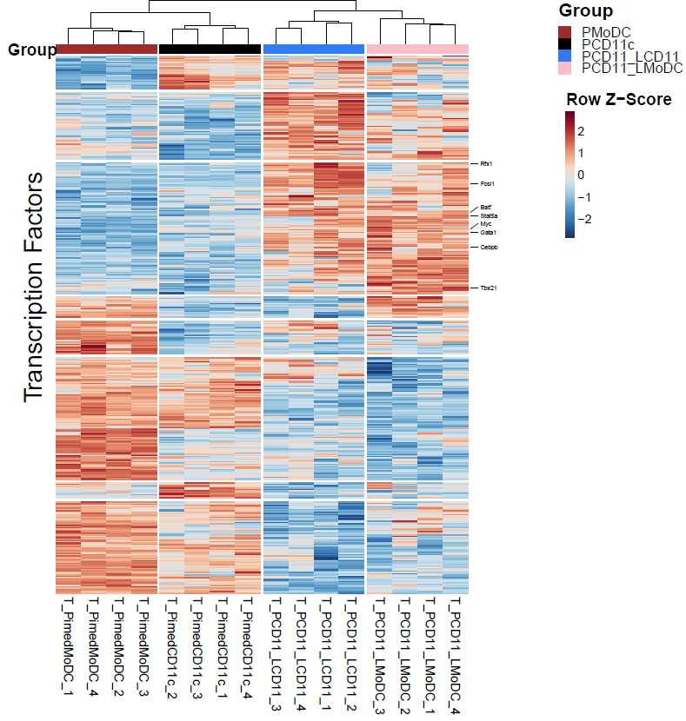
CD8+ T cells Primed/Licensed vs CD3_28 vs Naïve In Vitro Mice Bioinformatic Results
Heatmap of Transcription Factors (TFs) of interest:
This heatmap presents the expression of chosen TFs’ genes from Shai Dulberg’s Mouse TFs gene list.
Rfx1,Fosl1,Batf,Stat5a,Myc,Gata1,Cebpb and Tbx21.
Batf, Tbx21.

Slide 56

CD8+ T cells Primed/Licensed vs CD3_28 vs Naïve In Vitro Mice Bioinformatic Results
Heatmap Ligands of interest:
This heatmap presents the expression of chosen Ligands’ genes from Shai Dulberg’s Ligands-Receptors gene list.
Amigo2,Cmtm8,Vegfb,Yars,Psen1,Dll4,Ebi3,Ccl4,Csf1,Il10,Pvr,Il12a, Il1rn,Fbrs,Pdgfa,Grn,Tnfsf9,Gzmb, Camp,Plekho2,Tph1,Nrg4,Cd320, Tgfb1,Pglyrp1,Mif,Gpi1,Arf1,Hdc, Serpine2,Alox5ap and Ctsg.
Tgfb1, Pglyrp1

Slide 57

CD8+ T cells Primed/Licensed vs CD3_28 vs Naïve In Vitro Mice Bioinformatic Results
Heatmap Receptors of interest:
This heatmap presents the expression of chosen Receptors’ genes from Shai Dulberg’s Ligands-Receptors gene list.
Rrbp1,Ptpn6,Pde1b,Pdcd1,Vcam1,Ogfr,Ager,Itga5,Mpl,M6pr,Cd40, Ifnar2,Rpsa,Slc1a5,Cxcr4,Traf2, Tnfrsf8,Robo3,Gpr84,Tnfrsf12a, Adgrl1 and Nlgn2.

Slide 58
Circos Plot Methods PcDC_LMoDC
Ligand
Ligands (MoDCs / cDCs In vitro) → Receptors (T cells In vitro)
Ligands-Receptors table from NicheNet for Circos plot connections.
PPI from MIPPIE.
DSA calculation using max flow network.
ADD VISUALIZATION OF THE CAPACITIES AND PPI …
R
p1
p2
p3
p4
p5
TF1
p6
TF2
TF3
/Inf
/Inf
/Inf
Virtual Sink

Slide 59
Circos Plot Methods PcDC_LMoDC
Ligand
DSA calculation using max flow network:
Enrichment test of TFs from TF-Target table in the raw counts data (Hypergeometric test; Up regulated PcDC_LMoDC samples)
88 enriched TFs.
Capacities = (Pearson correlations for every gene pair from all samples counts) X (the mean expression of the gene pair in PcDC_LMoDC samples counts.)
Infinity capacity for every enriched TF and the virtual sink.
DSA value = max flow value in the network/ degree centrality.
The degree centrality = deg(v) / (n-1) .
P-value for each DSA value was calculated using permutation test.
R
p1
p2
p3
p4
p5
TF1
p6
TF2
TF3
/Inf
/Inf
/Inf
Virtual Sink

Slide 60
Circos Plot Methods PcDC_LMoDC
Ligand
DSA calculation using flow network:
Enrichment test of TFs from TF-Target table in the raw counts data (Hypergeometric test; Up regulated PcDC_LMoDC samples) – for each TF how much the targets are expressed in the raw data.
88 enriched TFs.
Capacity for each edge calculated by Pearson correlations for every gene pair from all samples counts times the mean expression of the gene pair in PcDC_LMoDC samples counts.
Infinity capacity for every enriched TF and the virtual sink.
DSA value = max flow value in the network/ degree centrality
The degree centrality = deg(v) / (n-1)
P-value for each DSA value was calculated using permutation test and then applied 1 sample t-test.
R
p1
p2
p3
p4
p5
TF1
p6
TF2
TF3
/Inf
/Inf
/Inf
Virtual Sink

Slide 61

Circos Plots Methods
Ligands (MoDCs / cDCs) → Receptors (T cells in vitro)
DSA calculation (Shai’s implementation): (Change to Mine)
Ligands-Receptors table from NicheNet.
PPI from STRING.
Score of PPI above threshold 100.
Up to 3 levels of PPI.
DSA(L→R→PPI) = $\frac{P1Exp+P2Exp+P3Exp+P4Exp+P5Exp}{5}$
Ligand
R
Level 1
p1
Level 2
p2
p3
p4
Level3
p5

Slide 62

MoDC In Vitro vs CD8+ T cells In vitro Circos Plots
Up regulated DEGs MoDC_6H_In_Vitro VS
MoDC_Naive
Up regulated DEGs MoDC_6H_In_Vitro VS
cDC_6H_In_Vitro
$$∩$$
Up regulated DEGs T cells PcDC_LMoDC VS T cells PcDC Receptors
Ligands filtering
MoDC_6H_Unique Ligands
Circos with
MoDC_6H_Unique Ligands
MoDC_6H_Unique Ligands
Up regulated DEGs
T cells PcDC_LMoDC VS T cells PMoDC Receptors
Circos with

Slide 63

MoDC In Vitro vs CD8+ T cells In vitro Cxcr4 Receptor
Ligands
Receptor

Slide 64

MoDC In Vitro vs CD8+ T cells In vitro Traf2 Receptor
Ligands
Receptor

Slide 65

MoDC In Vitro vs CD8+ T cells In vitro Tnfrsf1b Receptor
Ligands
Receptor

Slide 66

MoDC In Vitro vs CD8+ T cells In vitro Circos Plots

Slide 67

MoDC In Vitro vs CD8+ T cells In vitro Circos Plots

Slide 68
Motivation MoDC In Vitro Experiment with 48H Wash
What are the transcriptomic differences between MoDCs after 6H treatment of LPS vs MoDC 48H Wash and Naïve MoDCs?

Slide 69
MoDC Activated vs Washed vs Naive In Vitro Mice Bench Results

Slide 70

MoDC Activated vs Washed vs Naive In Vitro Mice Bioinformatic Results
PCA Plot

Slide 71

MoDC Activated vs Washed vs Naive In Vitro Mice Bioinformatic Results
Volcano Plot 48H treatment vs Naive:
Labeled the following list of interest genes: "Il27","Il1b","Ifi205","Ifit3","Cd40", "Tnfsf15","Ccl5","Ifit3b","Cxcl10", "Cxcl2","Ifit2","Tnf","Il12b","Il12a", "Isg20","Socs3","Ccl4" and "Cxcl1" .
And top 10 P-value genes in logFC > 2 or logFC < -2 .

Slide 72

MoDC Activated vs Washed vs Naive In Vitro Mice Bioinformatic Results
Volcano Plot 6H treatment vs 48H Wash:
Labeled the following list of interest genes: "Il27","Il1b","Ifi205","Ifit3","Cd40", "Tnfsf15","Ccl5","Ifit3b","Cxcl10", "Cxcl2","Ifit2","Tnf","Il12b","Il12a", "Isg20","Socs3","Ccl4" and "Cxcl1" .
And top 10 P-value genes in logFC > 2 or logFC < -2.

Slide 73

MoDC Activated vs Washed vs Naive In Vitro Mice Bioinformatic Results
Heatmap of All Differentially Expressed Genes (DEG):
Applied LRT test in DESeq DEG function across all samples.
Then kept only DE genes with padj (FDR) value less than 0.05.
5162 genes are present and condensed in the following heatmap to see the overall effect of each group on the MoDC cells.

Slide 74

MoDC Activated vs Washed vs Naive In Vitro Mice Bioinformatic Results
Heatmap of Transcription Factors (TFs) of interest:
This heatmap presents the expression of chosen TFs’ genes from Shai Dulberg’s Mouse TFs gene list.
Zfp637,Zfp358,Ddit3,Zbtb7b,Hlx, Runx1,Bcl6,Bhlhe41,Pou2f2,Ankzf1,Pou5f2,Klf4,Zfp697,Hivep2,Tcf7, Myc and Bcl11b

Slide 75

MoDC Activated vs Washed vs Naive In Vitro Mice Bioinformatic Results
Heatmap Ligands of interest:
This heatmap presents the expression of chosen Ligands’ genes from Shai Dulberg’s Ligands-Receptors gene list.
Cd274,Itgb1,Csf1,Cd40,Tnf,Il15,Icam1,Cd200,Itga4,Tnfsf10,Il27,Cxcl9,Itgal, Osm,Pvr,H2−M3,Ccl5,Cxcl16,Tnfsf9, Il18,Il13,Ccl12,Icosl,Il12b,Cxcl2,Cxcl1, Il12a,Tnfsf4,Cxcl10,Il6,Il1rn,Il1b,Ccl2, Cd86,Lgals3,Csf2,Ccl22,Il1a,Ccl17,Il33,Xcl1,Cxcl11,Ifng,Sell,Ccl7,Tnfsf8,Il10, Cd70,Cd28,Selplg,Tnfsf13b,Il16 and Tnfsf12

Slide 76

MoDC Activated vs Washed vs Naive In Vitro Mice Bioinformatic Results
Heatmap Receptors of interest:
This heatmap presents the expression of chosen Receptors’ genes from Shai Dulberg’s Ligands-Receptors gene list.
Fcgr2b,Ptger4,Alox5,Prnp,Lsr, Siglec1,Abca7,S1pr1,Fkbp1b and Atrn
F2rl2,Slc40a1,Cd34,Cd74,Nrp1, Ryr1,Il12rb2,F3,Mertk,Itga4,Rack1,Itga2b,Gp5,Gp9,Csf2ra and Siglecf

Slide 77

MoDC Activated vs Washed vs Naive In Vitro Mice Bioinformatic Results
DEGs tables have been taken from each part of the Venn.

Slide 78

MoDC Activated vs Washed vs Naive In Vitro Mice Bioinformatic Results
Bar plot exhibiting the average normalized expression of the gene Cxcr4 in each group with SD.
Applied ANOVA post hoc test for significance calculation.

Slide 79

MoDC Activated vs Washed vs Naive In Vitro Mice Bioinformatic Results
Bar plot exhibiting the average normalized expression of the gene Cx3cr1 in each group with SD.
Applied ANOVA post hoc test for significance calculation.

Slide 80
CD8+ T Cells Human Datasets
https://www.sciencedirect.com/science/article/pii/S1368837523002208?via%3Dihub Tumor LN vs LN.
https://www.sciencedirect.com/science/article/pii/S0092867423001642 CD8+ T cells in Tumor vs in LN.
https://www.sciencedirect.com/science/article/pii/S153561082300082X T cells in tumor vs in LN.

